Slide 1
Rubix codefest JBoss Fuse
Hands on JBoss Fuse

Slide 2
Introduction and prerequisites
Implementing an end to end integration scenario existing of three use cases which build on each other.
Prerequisites:
(virtual) machine with the following install base:
JDK 1.7.x (works with both openJDK and Oracle JDK)
Maven 3.x
JBoss Fuse 6.1 (Full zip)
JBoss developer studio 7 + integration stack
SoapUI (optional)
Supplied resources(xsd’s, csv’s, pom.xml, etc.) see: sheets resources
Instructional word document
A full working version of the integration scenario can be accessed here: https://github.com/pimg/rubixcodefest

Slide 3
Introduction and prerequisites 2
Fully installed virtualbox image available on Rubix NAS (based on Fedora Linux)
Username/password: jboss/jboss
Root username/password: root/jboss
Or install the products yourself:
JDK 1.7.x (works with both openJDK and Oracle JDK)
Maven 3.x http://maven.apache.org/download.cgi
JBoss Fuse 6.1 (Full zip) http://www.jboss.org/products/fuse/download/
JBoss developer studio 7 + integration stack http://www.jboss.org/products/devstudio/download/
SoapUI (optional)
JBoss installation manuals:
https://access.redhat.com/documentation/en-US/Red_Hat_JBoss_Fuse/6.1/html/Installation_Guide/index.html
https://access.redhat.com/documentation/en-US/Red_Hat_JBoss_Fuse/6.1/html/Tooling_Installation_Guide/index.html
Overall Jboss Fuse documentation: https://access.redhat.com/documentation/en-US/Red_Hat_JBoss_Fuse/6.1/

Slide 4
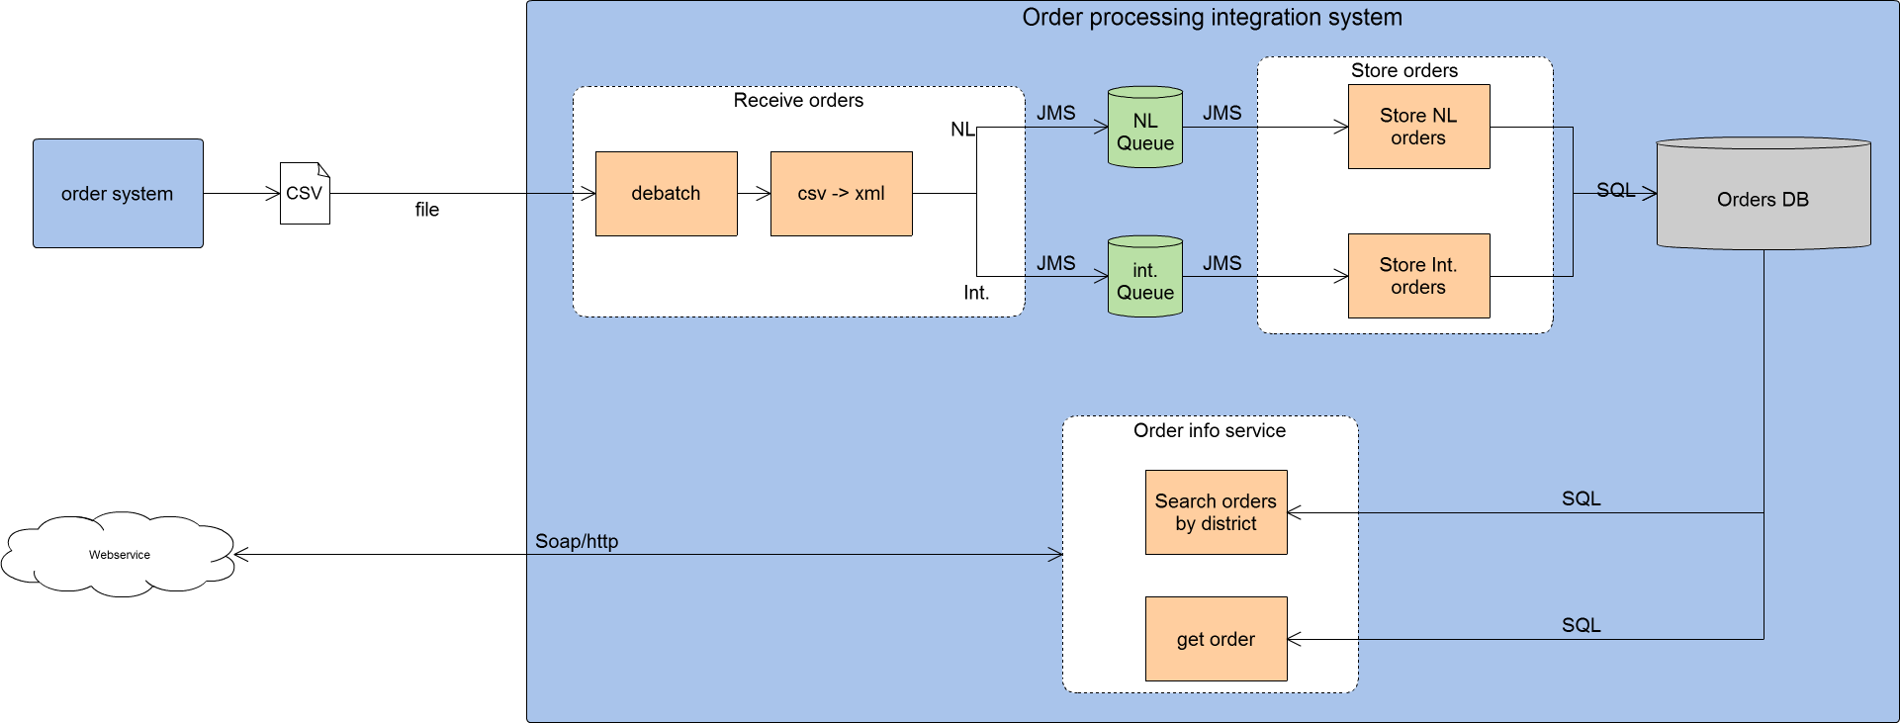
Overall solution

Slide 5
Resources
To speed up development some resources are supplied
These resources can be found here: https://github.com/pimg/rubixcodefest/tree/master/resources
The following resources are supplied
DatabaseBean.java – setup class for embedded Derby DB
OrderInfoService.wsdl – wsdl for the webservice
Order.xsd – xsd for the order message
Orders.csv – input csv file
Pom.xml – the maven pom file with all the dependencies and plugins
Shared-resources.xml – containing the embedded broker and database used in the other Camel contexts
Sql.properties – properties file containing the SQL queries for interacting with the database

Slide 6
Resources 2
In order to work correctly the resources have to be in certain locations in the Fuse project
Resource | location
DatabaseBean.java | /orderprocessing/src/main/java/nl/rubix/codefest/orderprocessing/sql/ (java package = nl.rubix.codefest.orderprocessing.sql)
OrderInfoService.wsdl | /orderprocessing/src/main/resources/wsdl/
Order.xsd | /orderprocessing/src/main/resources/xsd/
Orders.csv | Not used inside the project but in the file location used for testing
Pom.xml | (project root folder overwrite the generated pom.xml with this one)
Shared-resources.xml | /orderprocessing/src/main/resources/OSGI-INF/blueprint/
Sql.properties | /orderprocessing/src/main/resources/

Slide 7
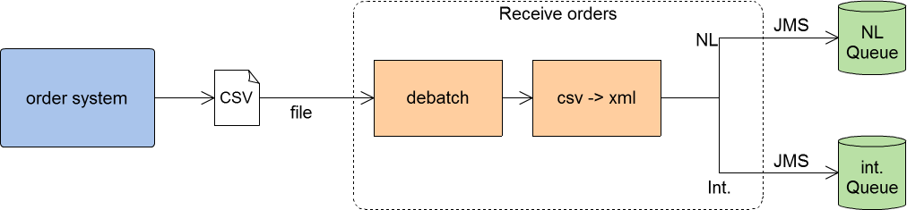
Use case 1 receive orders
Receive csv file
Debatch the file
Converting csv format to (CDM) xml
Content based router based on country
Publish on JMS queue (activemq)
Camel bindy for CSV to bean unmarshalling
Use the bean in splitter EIP (best practice for more robustness)
For the mapping to the (CDM) xml we use a custom processor (Java class)
The java bean we map to is generated from an xsd using JAXB
Use a content based router to route ‘NL’ orders to a different queue
Marshalling the JAXB bean will generate the xml document
publish the message on a JMS (activemq) queue

Slide 8
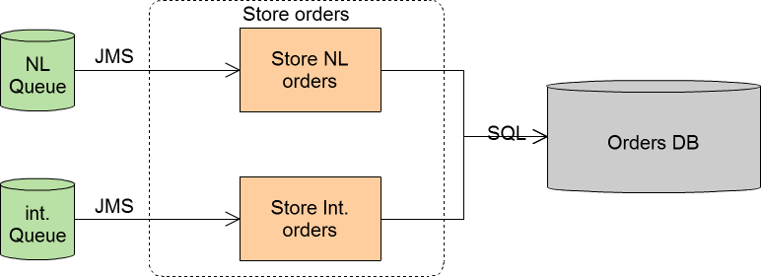
Use case 2 store orders
Receive message from JMS queue
Prepare message for insert into SQL database
Insert row in SQL database
Activemq for receiving the JMS message from the queues
JAXB for unmarshalling the xml document
Use header fields to store the individual data fields from the pojo used in the sql query
Use the SQL component for executing a SQL insert in the table
Using an embedded Apache Derby DB as a database.
Configuration in the following resources
Shared-resources.xml
DatabaseBean.java

Slide 9
Use case 2 store orders
CI’s used in the project
/orderprocessing/src/main/java/nl/rubix/codefest/orderprocessing/sql/DatabaseBean.java
/orderprocessing/src/main/resources/OSGI-INF/blueprint/shared-resources.xml
/orderprocessing/src/main/resources/OSGI-INF/blueprint/storeOrders.xml
/orderprocessing/src/main/resources/sql.properties
/orderprocessing/src/test/java/nl/rubix/codefest/orderprocessing/storeorders/StoreOrdersXmlTest.java
Tips & tricks
For demo purposes we use an embedded Apache Derby db, the configuration and setup is in DatabaseBean.java and shared-resources.xml
As a best practice the SQL statements are stored in a properties file sql.properties.
To use a properties file in Camel use <propertyPlaceholder id="placeholder" location="classpath:sql.properties"/> within the CamelContext. http://camel.apache.org/using-propertyplaceholder.html
Use the unmarshal processor to unmarshal the xml document back to a pojo using JAXB http://camel.apache.org/jaxb.html
The SQL queries are using named parameters to use these in Camel set header properties for these named parameters using the <setHeader headerName= statement
To set the content of the header use the simple expression language with the OGNL for retrieving the correct value. http://camel.apache.org/simple.html

Slide 10
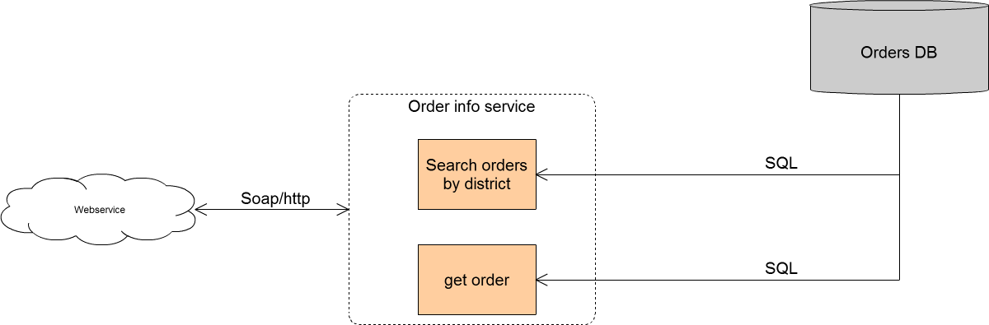
Use case 3 orderInfoService
Expose a webservice with two operations
Search orders by district (NL or IN)
getOrder by ID
Both operations query the database for retrieving the orders
Use CXF to expose a webservice
Use Camel to implement the business logic and routing of the webservice

Slide 11
Use Case 3 orderInfoService
CI’s used in the project:
/orderprocessing/src/main/java/nl/rubix/codefest/orderprocessing/mappings/SqlToSelectOrderByIdResponse.java
/orderprocessing/src/main/java/nl/rubix/codefest/orderprocessing/mappings/SqlToSelectOrderIdsResponse.java
/orderprocessing/src/main/resources/OSGI-INF/blueprint/OrderInfoService.xml
/orderprocessing/src/main/resources/OSGI-INF/blueprint/shared-resources.xml
/orderprocessing/src/main/resources/wsdl/OrderInfoService.wsdl
/orderprocessing/src/main/resources/sql.properties
/orderprocessing/src/test/java/nl/rubix/codefest/orderprocessing/orderinfoservice/OrderInfoServiceXmlTest.java
Tips & tricks
The maven wsdl2java cxf plugin will generate the necessary classes based on the wsdl
In the Camel context create an cxfEndpoint, to create this add the cxf namespace to the Blueprint context xmlns:cxf=http://camel.apache.org/schema/blueprint/cxf
In the cxfEndpoint refer to the service class which the plugin generated
The cxfEndpoint can be used as a Camel endpoint with the component cxf:bean
The Camel CXF Component, when acting as an endpoint consumer, will put an array of objects into the Camel message specifically an array of the request parameters. For Document-style web services, there will only be a single parameter. The transform(simple("${in.body[0]}")) step will extract that single POJO request object and place it into the Camel message body for processing by the rest of the route.
When implementing multiple operations use the content based router pattern and route based on soapaction in.header.SOAPAction to distinguish between operations.
When handling the generated objects directly in Java use the objectfactory class to instantiate the JAXB objects.
For select operations, the result is an instance of List<Map<String, Object>> type, as returned by the JdbcTemplate.queryForList() method. http://camel.apache.org/sql-component.html

